Slide 1
Exploring the Potential Energy Surface of various Molecules with a Problem-Inspired Ansatz
QHack Open Hackathon 2022
21-25 Feb 2022
Team: Qanything

Slide 2
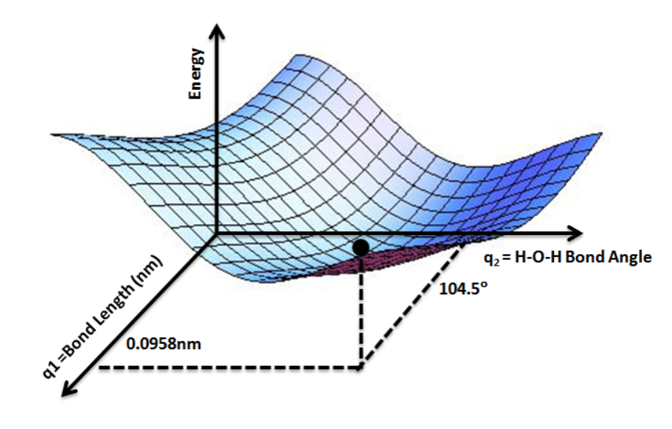
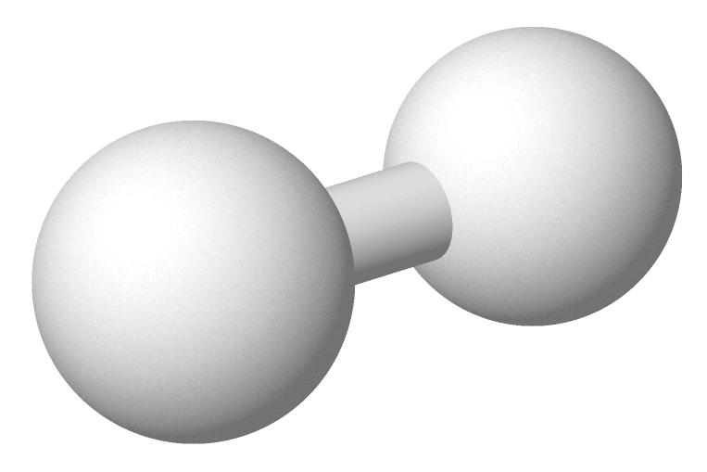
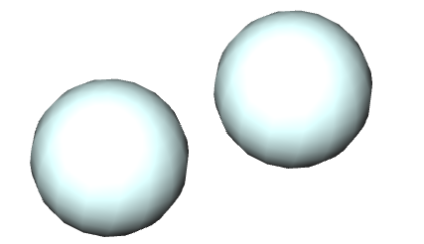
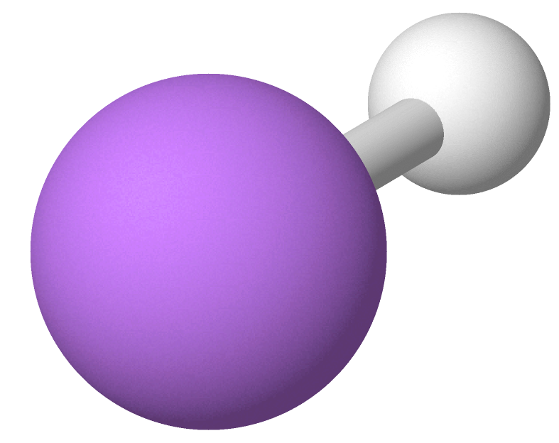


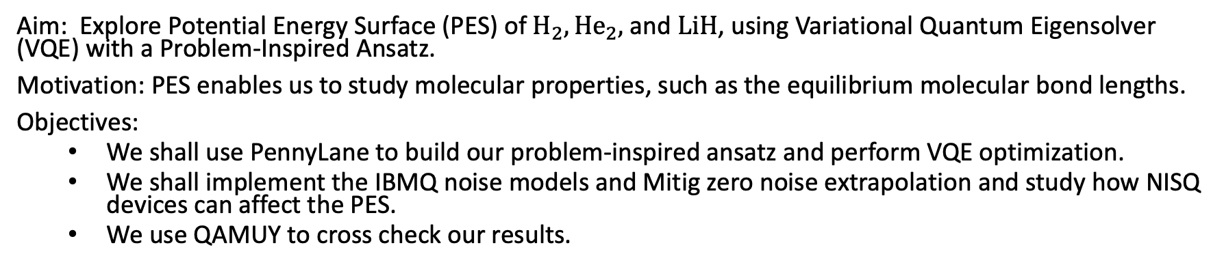

Project Aim
${\text{H}}_{2}$: Hydrogen molecule
${\text{He}}_{2}$: Helium Dimer
$\text{LiH}$: Lithium Hydride
Image Source: https://en.wikipedia.org/wiki/Potential_energy_surface#/media/File:Potential_Energy_Surface_for_Water.png
Aim: Explore Potential Energy Surface (PES) of ${\text{H}}_{2}, {\text{He}}_{2}\text{,}$ and $\text{LiH}$, using Variational Quantum Eigensolver (VQE) with a Problem-Inspired Ansatz.
Motivation: PES enables us to study molecular properties, such as the equilibrium molecular bond lengths.
Objectives:
We shall use PennyLane to build our problem-inspired ansatz and perform VQE optimization.
We shall implement the IBMQ noise models and Mitig zero noise extrapolation and study how NISQ devices can affect the PES.
We use QAMUY to cross check our results.

Slide 3
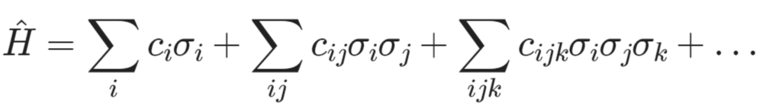
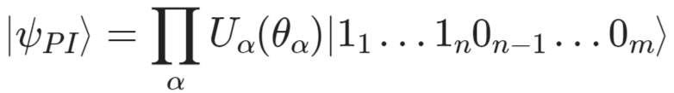

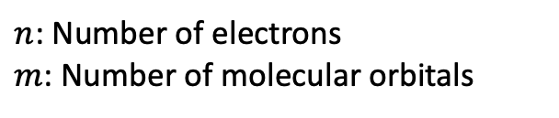
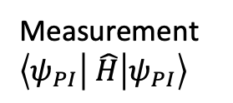
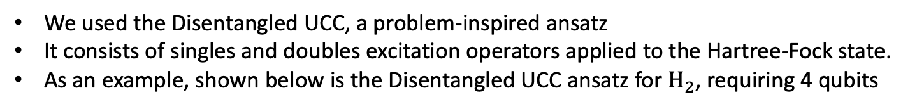


Molecular Hamiltonian and the Problem-Inspired Ansatz
Molecular Hamiltonian is an energy operator consisting of all electrons and the nucleus of the molecule
It can be decomposed as a linear combination of Pauli strings
VQE can be used to find the minimum energy of the molecular Hamiltonian
Our Problem-Inspired Ansatz
$n$: Number of electrons
$m$: Number of molecular orbitals
Disentangled UCC
Singles
Doubles
$θ$: Parameters to Optimise
We used the Disentangled UCC, a problem-inspired ansatz
It consists of singles and doubles excitation operators applied to the Hartree-Fock state.
As an example, shown below is the Disentangled UCC ansatz for ${\text{H}}_{2}$, requiring 4 qubits
Measurement $\left\langle ψ_{PI} | \hat{H} | ψ_{PI}\right\rangle$
Hartree-Fock state
PennyLane Quantum Circuit for ${\text{H}}_{2}$

Slide 4
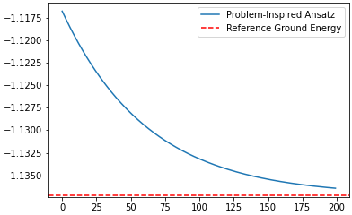
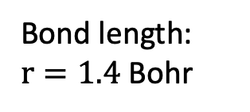


Performing VQE Energy Optimisation using PennyLane
VQE optimization of Hydrogen Molecule${\text{H}}_{2}$
${\text{H}}_{2}$: Hydrogen molecule
PennyLane with Our Ansatz
Bond length:
$r=1.4$ Bohr
Electronic energy (Hartree)
Parameters are Optimized using Gradient Descent with Default Settings
No. of Electrons: 2
No. of Qubits: 4
No. of Pauli Strings (to measure): 15
No. of Single Excitations Rotations Gate : 4
No. of Double Excitations Rotations Gate : 1
Total No. of Excitations Parameter: 5
Optimizer iterations

Slide 5
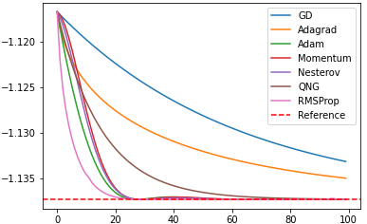

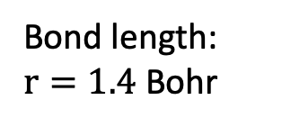
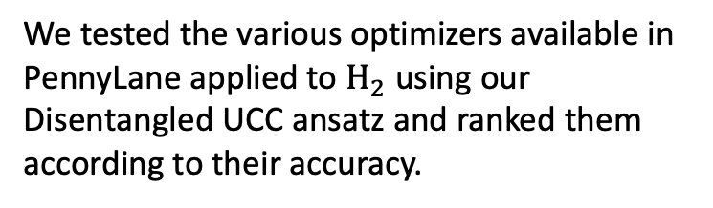
Benchmarking Using PennyLane Built-in Classical Optimizers
VQE optimization of Hydrogen Molecule${\text{H}}_{2}$
${\text{H}}_{2}$: Hydrogen molecule
Bond length:
$r=1.4$ Bohr
PennyLane with Our Ansatz
We tested the various optimizers available in PennyLane applied to ${\text{H}}_{2}$ using our Disentangled UCC ansatz and ranked them according to their accuracy.
Electronic energy (Hartree)
Optimiser Ranking:
RMSProp
Adam
Nesterov
Momentum
QNG
Adagrad
Gradient Descent
Optimizer iterations

Slide 6
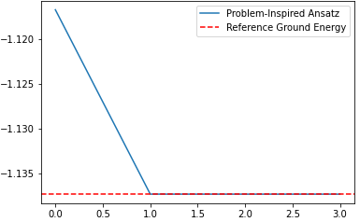
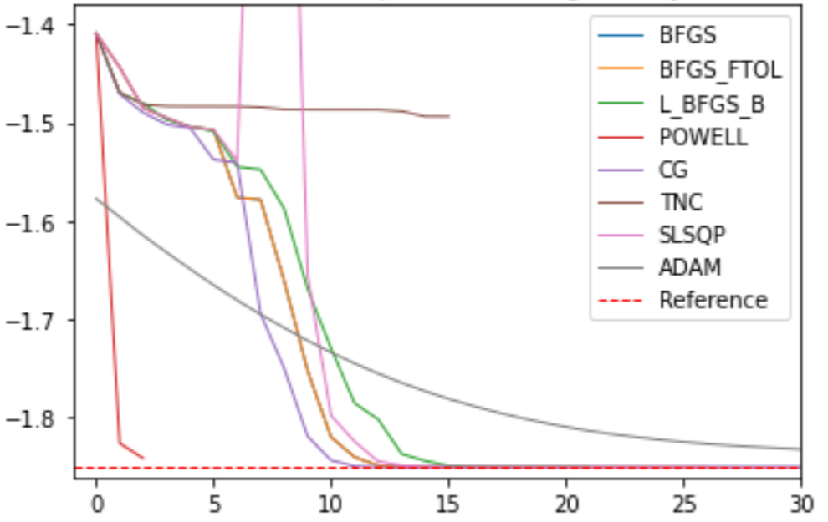
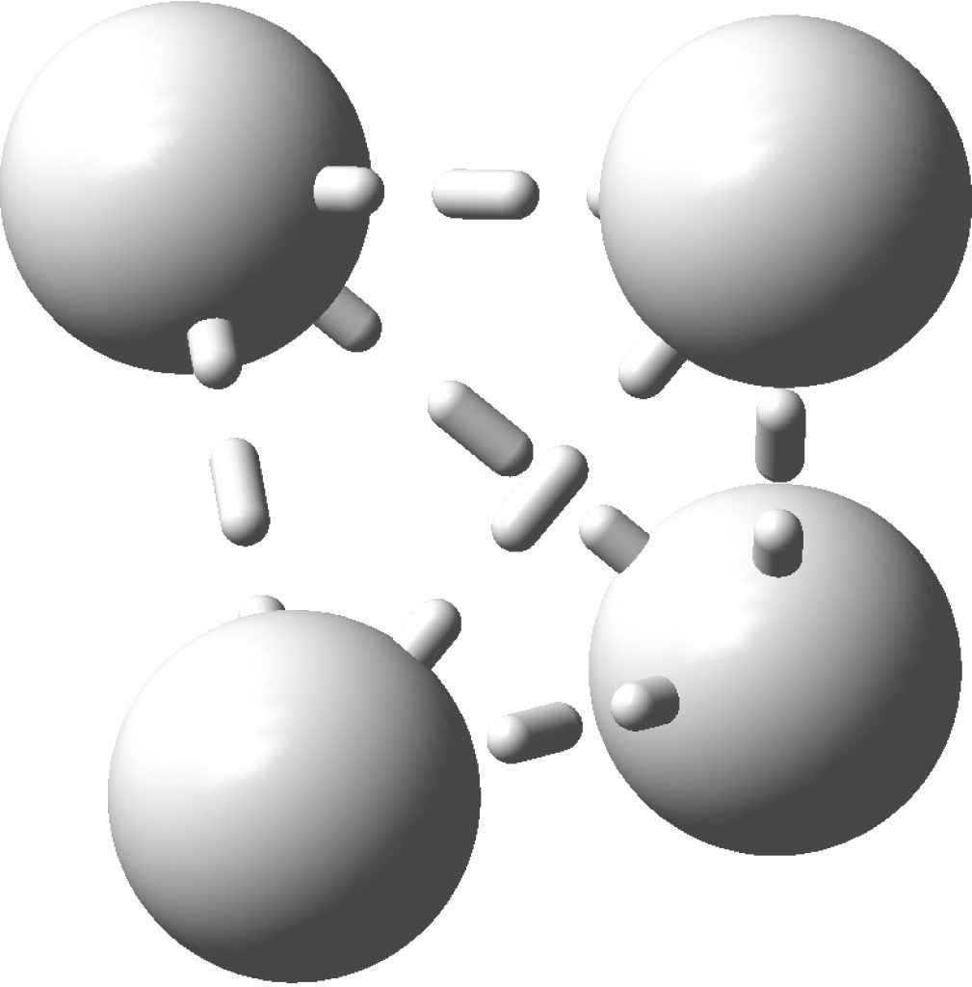
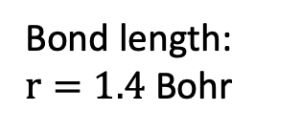
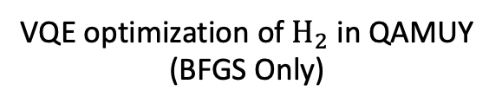
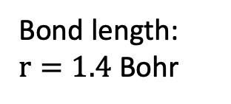

Implementing VQE on ${\text{H}}_{2}$ and Tetra Hydrogen ${\text{H}}_{4}$ with QAMUY
VQE optimization of ${\text{H}}_{2}$ in QAMUY
(BFGS Only)
VQE Optimisation of Tetra Hydrogen ${\text{H}}_{4}$ Various in QAMUY (Various Optimisers)
QAMUY
with their UCCSD Ansatz
QAMUY
with their UCCSD Ansatz
Electronic energy (Hartree)
Bond length:
$r=1.4$ Bohr
Bond length:
$r=1.4$ Bohr
Optimizer iterations
Optimizer iterations
The optimizers from QAMUY were able to provide accurate results with quick convergence
Image Source ${\text{H}}_{4}$: Henry Rzepa, https://www.ch.imperial.ac.uk/rzepa/blog/?p=17483

Slide 7
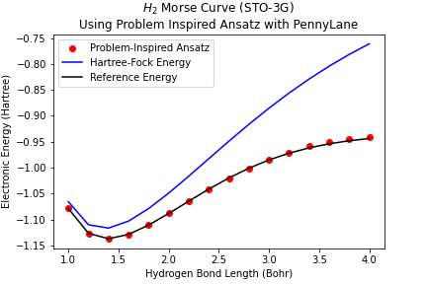
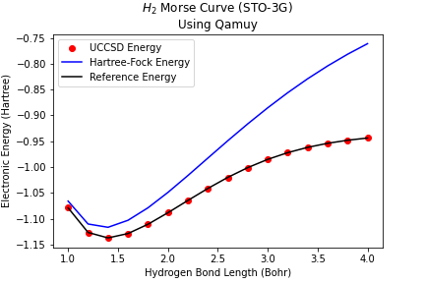
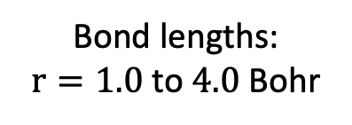
Potential Energy Surface for ${\text{H}}_{2}$ using Exact Quantum Simulator
PennyLane with Our Ansatz
QAMUY
with their UCCSD Ansatz
Bond lengths:
$r=1.0$ to $4.0$ Bohr

Slide 8
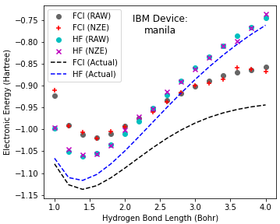
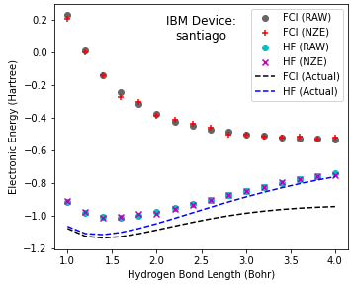
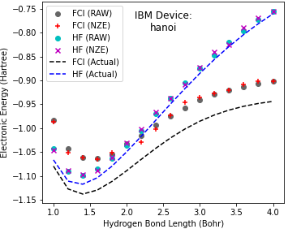
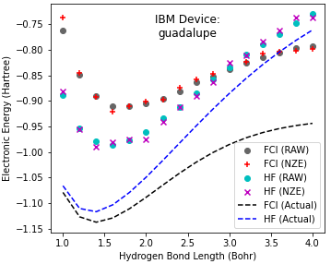
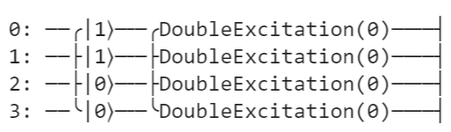
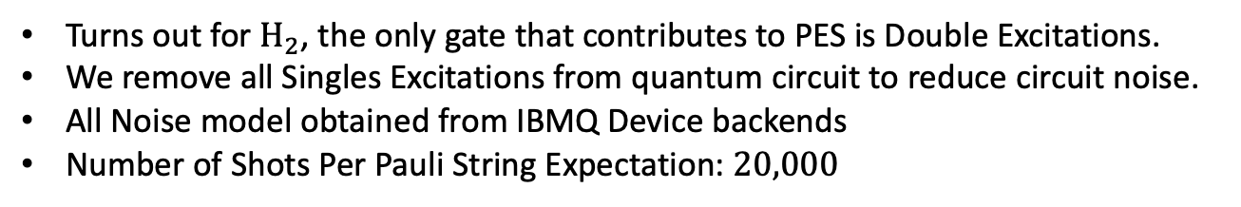
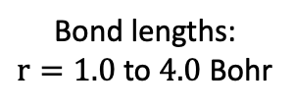
Potential Energy Surface for ${\text{H}}_{2}$ using various IBMQ Device Noise Models
Open Providers
Exclusive providers
Best performing
Worst performing
Best performing
Worst performing
Legend
GREY Dots: Our Optimised Problem Inspired Ansatz
+ : Problem Inspired Ansatz w/ Mitiq Zero Noise Extrapolation
CYAN Dots: Hartree-Fock (HF) State Only
X : HF w/ Mitiq Zero Noise Extrapolation
Note: From the plots, our implementation of Mitig as an error mitigation technique did not appear to help with improving the accuracy of our results. (???)
Bond lengths:
$r=1.0$ to $4.0$ Bohr
Actual Quantum Circuit Implemented:
Turns out for ${\text{H}}_{2}$, the only gate that contributes to PES is Double Excitations.
We remove all Singles Excitations from quantum circuit to reduce circuit noise.
All Noise model obtained from IBMQ Device backends
Number of Shots Per Pauli String Expectation: $20,000$

Slide 9
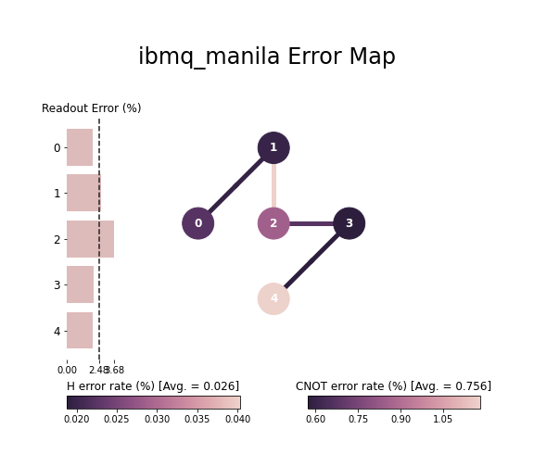
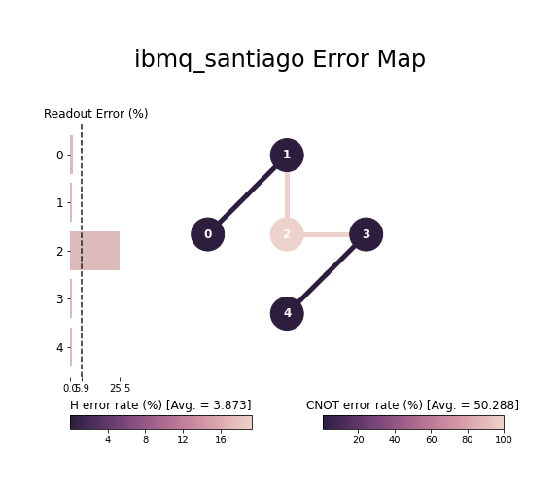
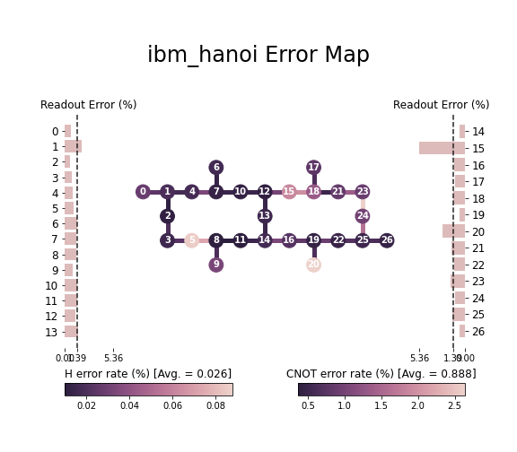
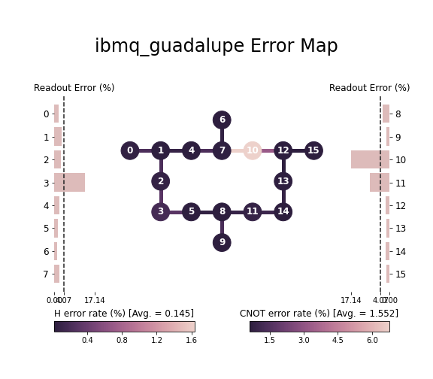
Potential Energy Surface for ${\text{H}}_{2}$ using various IBMQ Device Noise Models
Open Providers
Exclusive Providers
Best performing
Worst performing
Best performing
Worst performing
Simulated IBM Quantum Devices Noise Map

Slide 10
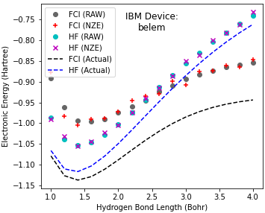
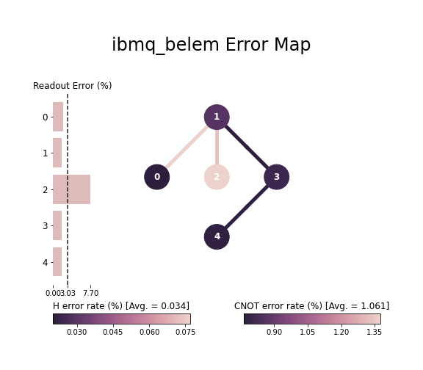
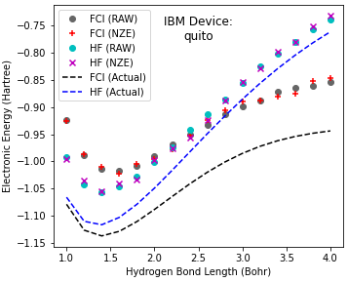
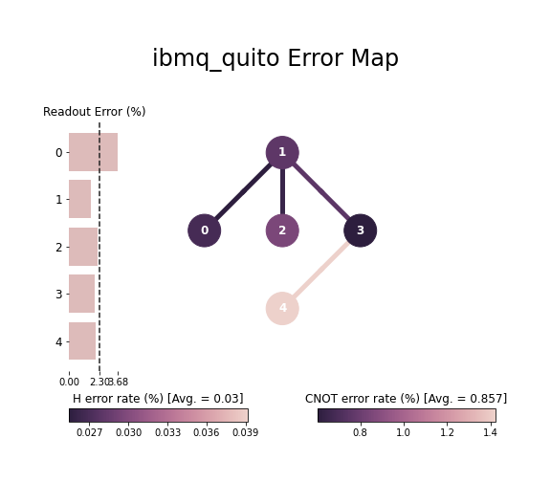
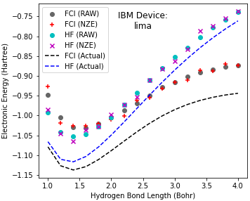
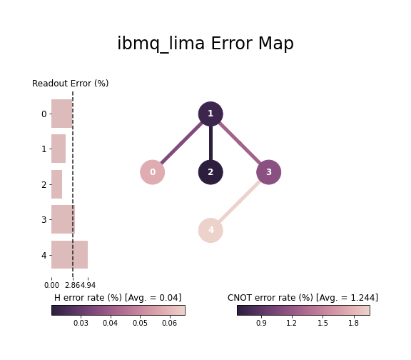
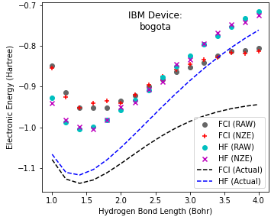
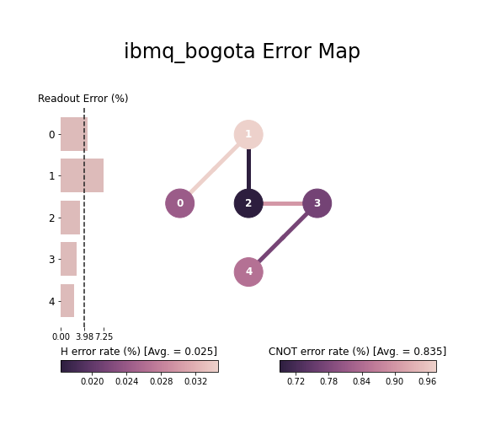
Potential Energy Surface for ${\text{H}}_{2}$ using various IBMQ Device Noise Models
Other Open Providers
Electronic energy (Hartree)
Electronic energy (Hartree)

Slide 11
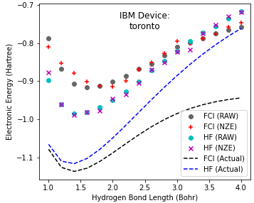
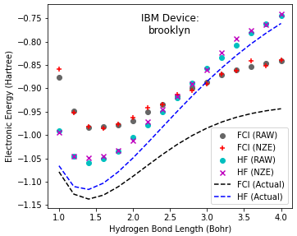
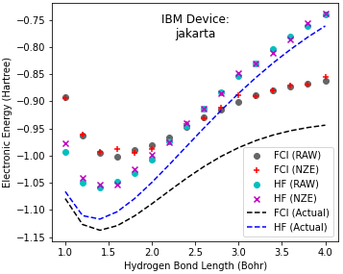
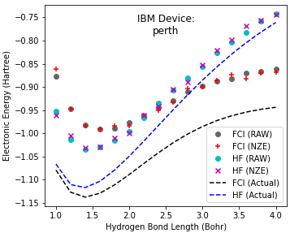
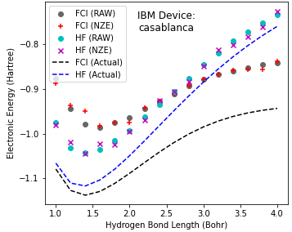
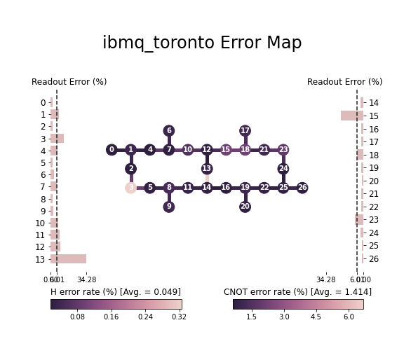
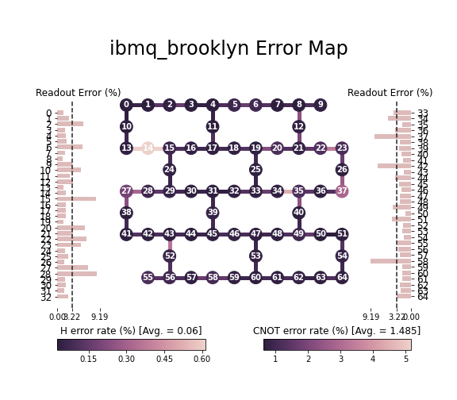



Potential Energy Surface for ${\text{H}}_{2}$ using various IBMQ Device Noise Models
Other Exclusive Providers
Electronic energy (Hartree)

Slide 12










Potential Energy Surface for ${\text{H}}_{2}$ using various IBMQ Device Noise Models
Other Exclusive Providers
Electronic energy (Hartree)

Slide 13





Potential Energy Surface for ${\text{H}\text{e}}_{2}$ using Exact Quantum simulator
PennyLane with Our Ansatz
Electronic energy (Hartree)
Electronic energy (Hartree)
Max Optimiser Iterations: 30
Total Runtime: ~1 Hour
Zoomed In
Distance:
$r=5.4$ to $6.8$ Bohr
Energy Optimisation of ${\text{H}\text{e}}_{2}@ 6Bohr$
No. of Electrons: 4
No. of Qubits: 8
No. of Pauli Strings (to measure): 185
No. of Single Excitations Rotation Gate: 16
No. of Double Excitations Rotations Gate: 36
Total No. of Excitations Rotation Parameter: 52
Hartree-Fock State: |1 1 1 1 0 0 0 0>
Note: Optimizers provided by PennyLane were unsuccessful in converging to the reference energy exactly in a limited number of steps (30 Iterations Max)

Slide 14




Potential Energy Surface for ${He}_{2}$ with QAMUY
${\text{He}}_{2}$ Morse Curve (6-31G)
QAMUY
with their UCCSD Ansatz
Electronic energy (Hartree)
Shallow Minimum
$∆E≈{10}^{−6}$ Hartree
Total Runtime: ~5 min
Distance:
$r=5.4$ to $6.8$ Bohr
There should be no Helium Bond as the energy depth is too shallow to support it.

Slide 15



Potential Energy Surface for $LiH$ using Exact Quantum simulator
QAMUY
with their UCCSD Ansatz
PennyLane with Our Ansatz
Max Optimiser Iterations: 20
Total Runtime: ~5 Hours
Total Runtime: ~2 Hours
No. of Electrons: 4
No. of Qubits: 12
No. of Pauli Strings (to measure): 631
No. of Single Excitations Rotations Gate : 32
No. of Double Excitations Rotations Gate: 168
Total No. of Excitations Rotation Parameter: 200
Hartree-Fock State: |1 1 1 1 0 0 0 0 0 0 0 0>
Bond lengths:
$r=2.1$ to $3.9$ Bohr

Slide 16
Contributing Members
Team Members (NUS, CQT):
Chee Chong Hian (Main Lead, Coder, Curator)
Benjamin Tan (Proofreading, Curator)
Gan Beng Yee & Supanut Thanasilp (Tried in Running Our Quantum Circuit on Real IBM Devices, but it didn’t work due to Technical Issues)
Adrain Mak (Basic Proofreading, ASTAR)

